Slide 1




ADIDAS SALES PERFORMANCE DASHBOARD
BETECHIFIED Group 10 Project
© Aghe Marvellous || Data Analyst

Slide 2
TEAM
Group 10
Aghe Marvellous – Acting Team Lead
Akinlade Zumayyah Adeola
Madu Elizabeth Olasunbo
Ngwudike Emmanuella Ifedili
PAULSON EMMANUEL
Andrews Bassaw
Ifeacho Juliet
Ibtihaj Dako
John O. ONDOMA
Olajide Oluwadamilola Stella
Olajide Mary Oluwafayokemi
Afara Abdullah Adeshina
Ololade Christiana Fabowale
Precious Aluge
Philip Quaicoe
Oluwaropo Boluwade Odunayo
⁠Ezak Catherine Adia
Obiekwe Chikamso Benita
Elaigwu Moses Patrick
Emmanuela Chioma Okafor
Ayoola Adedoyin Blessing
Afolayan Akoniloluwa
Victoria Adebiyi
Odelade Pelumi John
Adekola Adewoyin Solomon
Omosanya Taofeek
OGUGUA CHIBUIKE
Okafor Judith Ogochukwu
BLESSILIA AMEDOR
Abraham Olumide
Flora Kyerewaa Ainooson
Jeffery Emmanuel Ugochukwu
Lydia Owusu
Omagu Michael
Onyinyechi Okwueri
⁠Ernest Agyemfra- Poku
⁠Oluwasegun Toluwaleyi Hannah
Abdusalam Zainab
Umaru Firdausi
Sanwo Toluwani
Olaniyan Mubarak
Emmanuel Akaluese
Saidu Mohammed
Obey Qudus Oluwanishola
Balogun Moyosola
© Aghe Marvellous || Data Analyst

Slide 3
Group 10
Introduction
Adidas operates across multiple regions and retail partners, offering a wide range of products through various sales channels such as in-store, online, and outlet stores. While large volumes of sales data are collected, these data are not always fully utilized to drive strategic business decisions.
This project analyzes Adidas’ sales performance using historical sales data to uncover insights into revenue, profitability, product performance, regional trends, and sales channels. By leveraging data analysis and visualization techniques in Excel, the study aims to identify top-performing and underperforming products, regions, retailers, and sales methods. The insights generated from this analysis support data-driven decision-making in areas such as marketing strategy, inventory allocation, and overall business optimization.
© Aghe Marvellous || Data Analyst

Slide 4

Group 10
Adidas lacks clear visibility into which product categories, retailers, regions, and sales channels generate the most revenue and profit. In addition, variations in customer behavior across locations and sales methods make it difficult to identify underperforming markets and effectively optimize marketing strategies, pricing, and inventory decisions using existing sales data.
Problem Statement
©Aghe Marvellous | Data Analyst

Slide 5


© Aghe Marvellous || Data Analyst
Objective
The objective of this analysis is to evaluate Adidas’ overall sales and profitability performance, identify top and underperforming product categories, regions, and sales channels, compare the sales contributions of key retail partners, assess the effectiveness of different sales methods, and generate actionable insights to support improved future sales strategies and promotional decisions.
Group 10

Slide 6
Dataset Overview
Group 10
The dataset contains Adidas sales transaction records across multiple retailers, regions, product categories, and sales channels over a defined time period. Key fields include order dates, retailer names, product details, sales method, total sales, operating margin, and operating profit. The dataset is designed to support performance analysis across products, regions, and channels, enabling data-driven business insights.
Dataset Cleaning Steps
To ensure accuracy and reliability of insights, several data cleaning and transformation steps were performed:
Validation and Correction of Financial Metrics An initial data quality check revealed inconsistencies in the Total Sales and Operating Profit values. These fields were recalculated using validated formulas to ensure accurate revenue and profitability analysis.
Recalculation of Operating Profit Operating Profit was recalculated using the corrected Total Sales and Operating Margin values to eliminate calculation errors and standardize profitability measurement across all records.
Date Feature Engineering The Date column was separated into:
Year
Month
Weekday
This enabled time-based analysis, including monthly, yearly, and weekday sales trend evaluations.
Product Categorization Product categories were extracted and separated from the Product field to create a standardized Product Category column (e.g., Footwear, Apparel, Accessories). This improved category-level comparison and performance analysis.
Data Consistency Checks Additional checks were conducted to ensure consistent formatting across retailer names, sales channels, and regions, reducing duplication and improving pivot table accuracy.
© Aghe Marvellous || Data Analyst

Slide 7
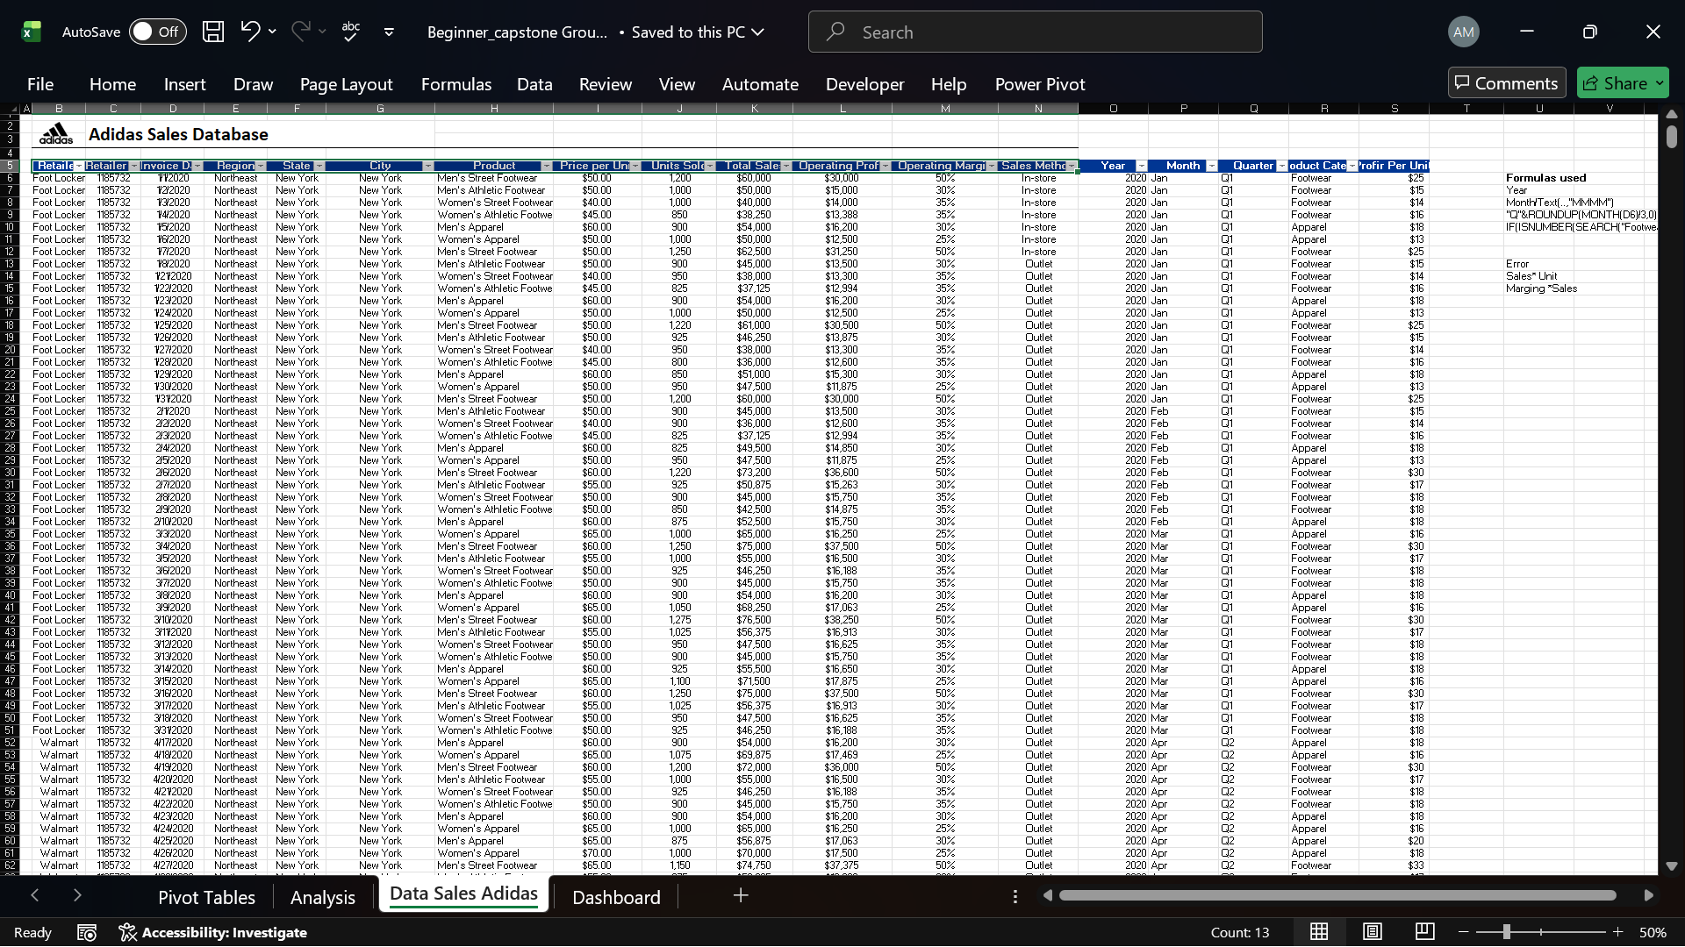
Dataset Overview
Group 10
© Aghe Marvellous || Data Analyst

Slide 8
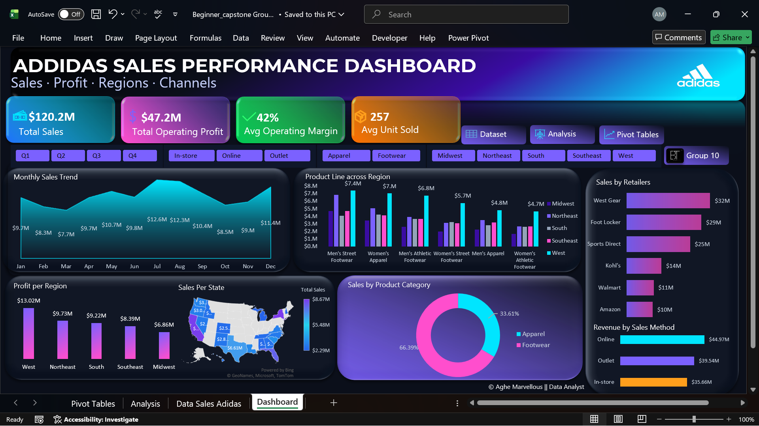
Dashboard Overview
Group 10
© Aghe Marvellous || Data Analyst

Slide 9
Group 10
KPIs OVERVIEW
$120.2M
$47.2M
42%
257
Total Operating Margin
AVG Operating Margin
AVG Unit Sold
Total Sales
Overall Performance .
Adidas generated $120.2M in total sales during the period.
Total operating profit reached $47.2M, resulting in a strong average operating margin of 42%.
This indicates that Adidas is not only driving revenue but also maintaining healthy profitability across its operations.
© Aghe Marvellous || Data Analyst

Slide 10
Key Business Questions
Which Adidas product categories generate the highest sales revenue?
Footwear is the highest revenue-generating product category, contributing approximately 66.4% of total sales, making it Adidas’ primary revenue driver. Apparel contributes about 33.6%, indicating strong but secondary performance. Accessories contribute a relatively smaller share compared to footwear and apparel.
What regions or store locations consistently deliver the strongest sales performance?
The West region consistently delivers the strongest sales and profitability across most product categories. This is followed by the Northeast and South regions, while the Midwest records comparatively weaker sales performance.
How do sales trends vary across different time periods?
Sales remain relatively stable throughout the year, with noticeable peaks during mid-year (June–August) and a recovery toward December. Lower sales in the early months suggest seasonal demand patterns, indicating opportunities for improved seasonal planning and promotions.
© Aghe Marvellous || Data Analyst

Slide 11
Key Business Questions
Who are the top performing retailers?
West Gear and Foot Locker are the top-performing retailers, contributing approximately $32M and $29M in sales respectively. Sports Direct also performs strongly, while Walmart and Amazon generate comparatively lower sales.
What sales method contributed more to revenue generation?
Online sales contribute the highest share of revenue, generating approximately $44.97M, followed by outlet sales ($39.54M) and in-store sales ($35.66M). This highlights a growing preference for digital and value-driven purchasing channels.
Are there specific products that show strong growth potential or declining demand?
Men’s Street Footwear and Women’s Apparel demonstrate strong growth potential, particularly in the West and Northeast regions. In contrast, certain product lines show weaker demand in the Midwest and Southeast, indicating declining or inconsistent performance in those markets.
© Aghe Marvellous || Data Analyst

Slide 12
Key Business Questions
How do Adidas sales compare to projected targets or benchmarks in different markets?
While explicit projected targets were not provided in the dataset, regional performance comparisons indicate that the West and Northeast regions outperform other markets, suggesting they are closer to or exceeding expected benchmarks. Underperforming regions such as the Midwest may be falling below internal performance expectations.
8. What are the top-performing product lines across regions?
Top-performing product lines are concentrated in the West and Northeast regions, particularly Men’s Street Footwear and Women’s Apparel. Performance varies significantly across other regions, reflecting differences in regional customer preferences and market demand.
© Aghe Marvellous || Data Analyst

Slide 13
Summary of key insights
Sales remain stable throughout the year, with clear peaks between June and August and a rebound toward December, indicating seasonal demand patterns.
Footwear dominates revenue, contributing approximately 66.4% of total sales, while apparel accounts for 33.6%, highlighting footwear as Adidas’ core revenue driver.
The West region consistently outperforms other regions in both sales and profitability across most product lines.
Men’s Street Footwear and Women’s Apparel show strong demand, particularly in the West and Northeast regions.
Several product lines underperform in the Midwest and Southeast, suggesting uneven regional demand and market fit challenges.
© Aghe Marvellous || Data Analyst

Slide 14
Summary of key insights
The West region leads in operating profit (approximately $13.02M), while the Midwest records the lowest profitability.
West Gear and Foot Locker are the top-performing retail partners, with Sports Direct also contributing significantly to total sales.
Walmart and Amazon generate comparatively lower sales, indicating potential underutilization or channel misalignment.
Online sales generate the highest revenue, followed by outlet and in-store channels, reflecting a shift toward digital and value-driven purchasing behavior.
© Aghe Marvellous || Data Analyst

Slide 15


Group 10
Business Implications
Adidas’ profitability indicates strong cost control and pricing efficiency.
Regional imbalances suggest that a one-size-fits-all strategy is ineffective.
Retailer concentration increases dependency risk on top-performing partners.
Growth in online sales reflects a need to prioritize digital commerce investments.
Underperforming regions may lead to inefficient inventory allocation if unaddressed.
© Aghe Marvellous || Data Analyst

Slide 16
Group 10
Recommendations
Product Strategy
Prioritize footwear innovation and expansion, especially in high-performing regions.
Reposition or redesign underperforming apparel lines to better suit regional preferences.
© Aghe Marvellous || Data Analyst

Slide 17
Group 10
Channel Optimization
Increase investment in online platforms, including targeted digital marketing and promotions.
Optimize outlet pricing strategies to clear inventory without eroding margins.
Enhance in-store experiences to remain competitive with online channels.
© Aghe Marvellous || Data Analyst

Slide 18
Group 10
Regional Focus
Expand marketing efforts and inventory allocation in the West and Northeast.
Introduce localized promotions and pricing strategies in Midwest and Southeast regions.
© Aghe Marvellous || Data Analyst

Slide 19
Group 10
Retailer & Partner Management
Strengthen partnerships with West Gear and Foot Locker through exclusive launches or incentives.
Reassess strategies with Walmart and Amazon to improve visibility and sales performance.
© Aghe Marvellous || Data Analyst

Slide 20
Group 10
Demand Forecasting
Use historical monthly sales trends to improve seasonal demand forecasting and inventory planning.
Anticipate higher demand during peak months and ensure adequate stock levels to prevent lost sales.
Reduce excess inventory during low-demand periods by aligning production and supply chain planning with forecasted demand.
© Aghe Marvellous || Data Analyst

Slide 21
Conclusion
This analysis demonstrates that Adidas is performing strongly overall, driven primarily by footwear sales, high-margin operations, and a growing online presence. However, performance varies significantly across regions, product lines, and retail partners. By leveraging these insights to refine product strategies, optimize sales channels, and adopt region-specific approaches, Adidas can improve operational efficiency, maximize profitability, and strengthen its competitive position in the market.
© Aghe Marvellous || Data Analyst

Slide 22
THANK YOU
Group 10
Presented by: Aghe Marvellous @Aghe Marvellous
© Aghe Marvellous || Data Analyst

